Slide 1
World Happiness
Data Analysis
ThanhVi Dang, Jasmine Coloma, Kyle Ryan

Slide 2
What is it?
The World Happiness Report, a widely-cited annual survey that ranks 156 countries by their levels of happiness
The joy scores and rankings utilize information from the Gallup World Survey.
The survey utilizes something called the Cantril step which asks the responder to envision the best possible life as being a ten and the worst possible life as being a zero then to place their current life on that scale
The Cantril step covers six different areas: financial generation, social backing, life anticipation, flexibility, nonattendance of debasement, and liberty.

Slide 3
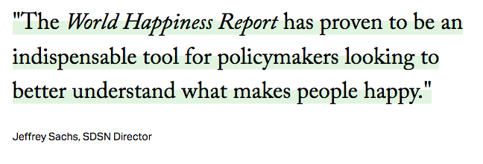
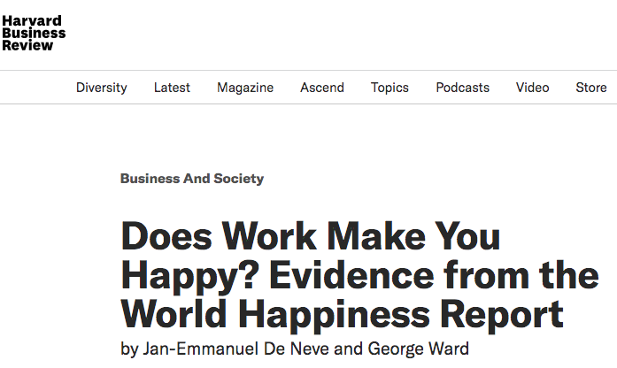
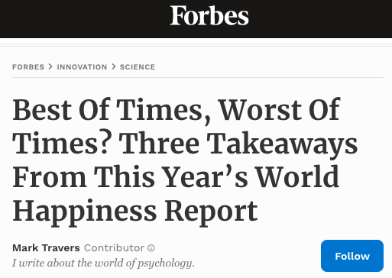
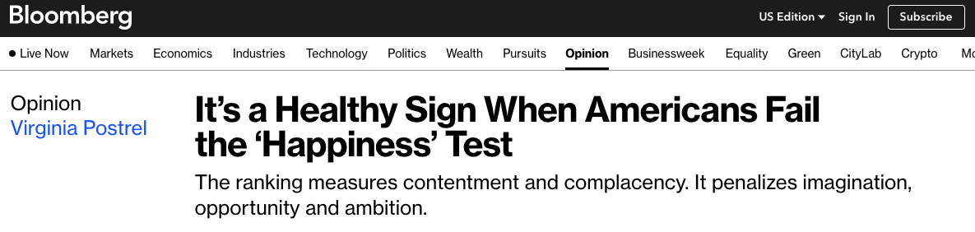

Previous Works
Featured in
The New York Times
The Washington Post
U.S. and World Report
Harvard Business Review
Huffington Post
Forbes
Bloomberg

Slide 4
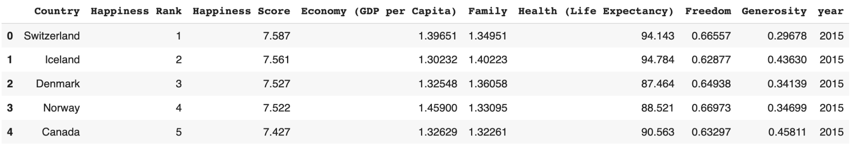

The Data

Slide 5
The Study
By implementing policies that improve these factors, countries could improve the overall joy in their countries. What factors have a major impact on a country or region’s happiness score?
Hypothesis: There is a positive correlation between GDP and life expectancy, and happiness score. As GDP and life expectancy increase, happiness score is also likely to increase.

Slide 6
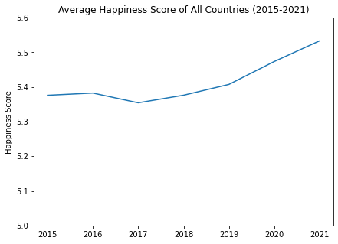
Time Series - Average Happiness Score
Time Series Graph: used to show how data is trending over time
Gradual increase between 2015 - 2021
Why? New technology → Better quality of life
Exponential growth between 2019 - 2021
Why? New expectations for well-being as a result of the Covid-19 pandemic
Notes:
Notes:
A time series plot is shown below comparing the average happiness score of all countries throughout the years 2015 to 2021.
score for happiness has gradually increased over time, despite a slight decrease between 2016 to 2017.
In turn, there is a huge jump in the average score for happiness between 2019 to 2021.
Although the recent Covid-19 pandemic has caused a lot of unprecedented chaos, it is also possible that it has created a strong impact on newer conceptions of what is important for living a good life as well as collective well-being.
A world-wide shutdown is likely what caused many people to rethink their values for quality of life.
Work-life balance, self-care, great resignation

Slide 7
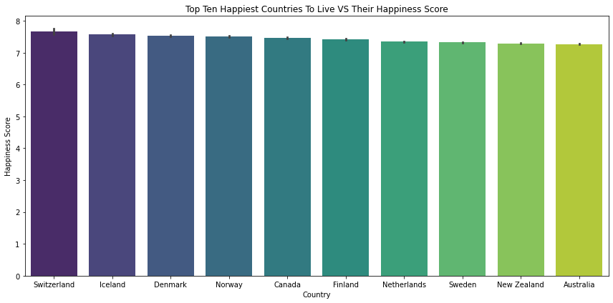
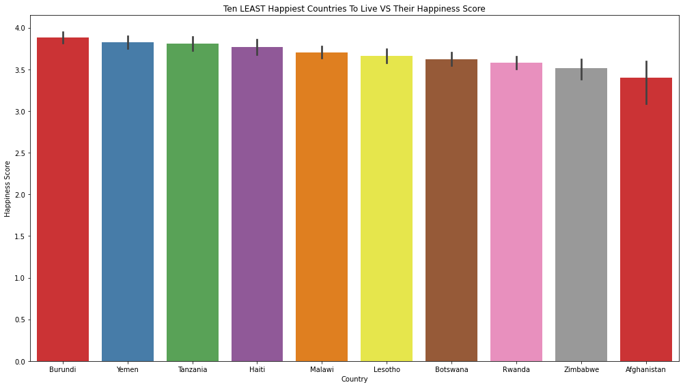
Bar Chart - Happiest Countries
Bar Chart: used to perform a comparison of metric values across different subgroups of our data
Happiest Countries:
values for GDP, Health, Social Support, Freedom, etc = HIGH
Least Happiest Countries:
Values for GDP, Health, Social Support, Freedom, etc = LOW
Notes:
Notes:
top ten happiest countries using their overall average happiness score between 2015 to 2021
Switzerland is in the top position, followed by Iceland, Denmark, and Norway.
According to the World Happiness Report in 2021, Finland had achieved top position for the fourth year in a row.
In turn, Afghanistan returns with the lowest average happiness score, making it the least happiness country out of the group.
It is also interesting to note that the United States does not make it in the global top ten.

Slide 8
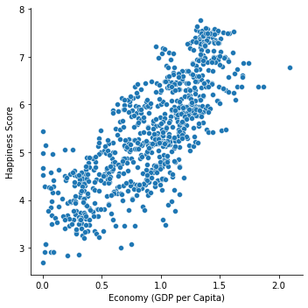
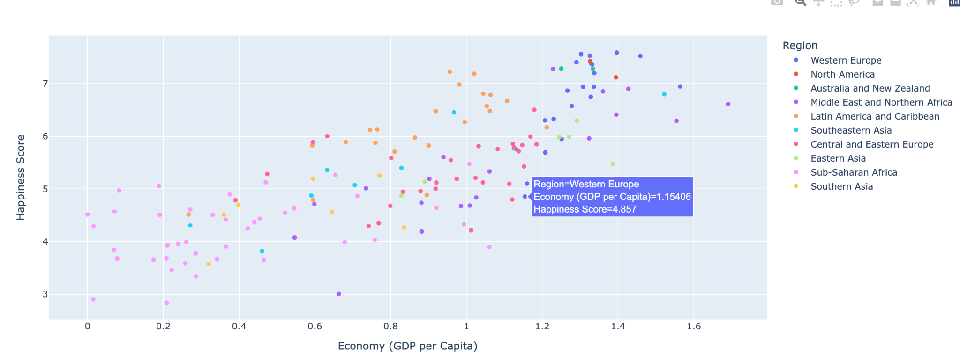
Scatter Plot (GDP)
Scatter Plot: shows the relationship between different variables
Happiness Score ~ Economy (GDP)
Positive Correlation
Increase in income = increase in standard of living = happiness
Notes:
Notes:
The scatter plot is shown to visualize the relationship between the economy and happiness score.
a clear correlation between GDP per Capita and national happiness, indicating that a country’s income plays a significant role in determining their overall life satisfaction.
It can be interpreted that the increase in one’s income leads to the increase in standard of living which does, in turn, create more happiness.

Slide 9
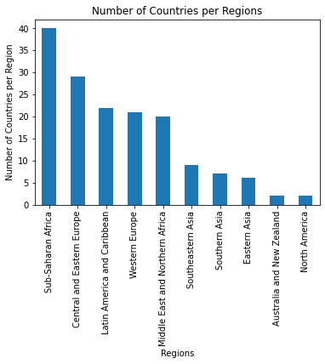
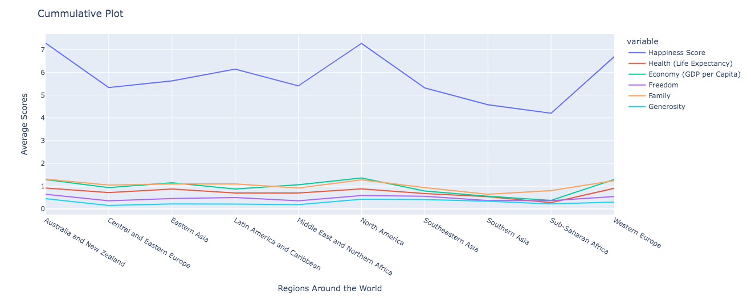
Cumulative Plot
Cumulative Plot: shows the average scores of the variables per regions
10 total regions
6 variables
Sub-Saharan African: lowest overall average scores
*Note: Health (Life Expectancy) values in this graph are divided by 100 to get a smaller value for graph purposes.

Slide 10
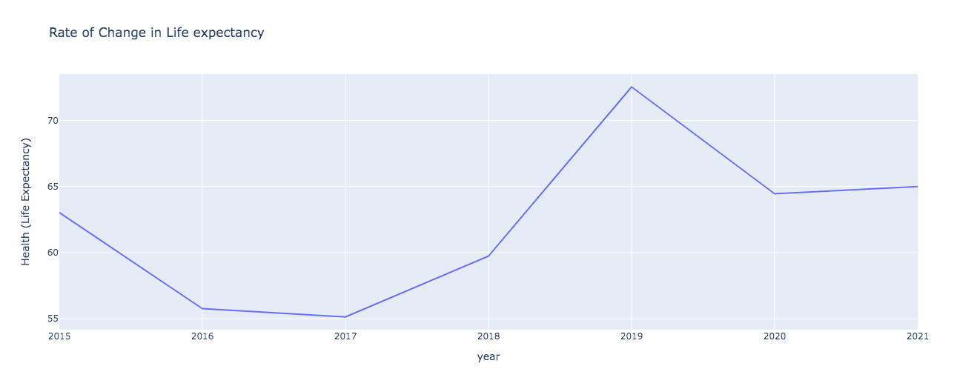
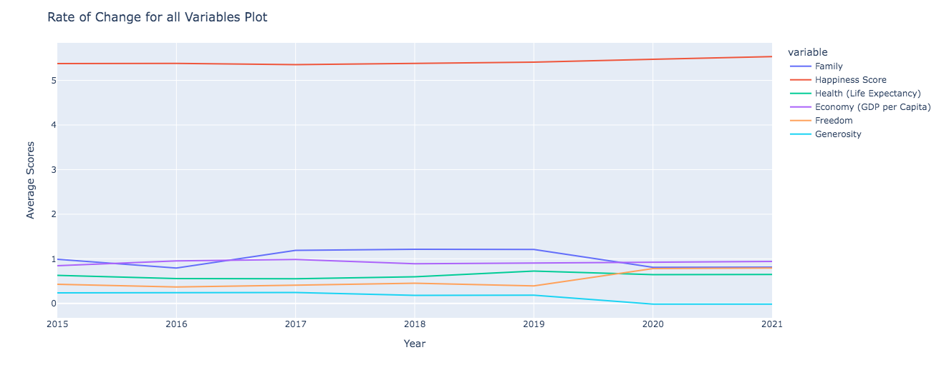
Rate of Change
Rate of Change Plot: shows how all variables in dataset trends between 2015-2021.
Health (Life Expectancy): 2020 drop
*Note: Health (Life Expectancy) values in this graph are divided by 100 to get a smaller value for graph purposes.

Slide 11
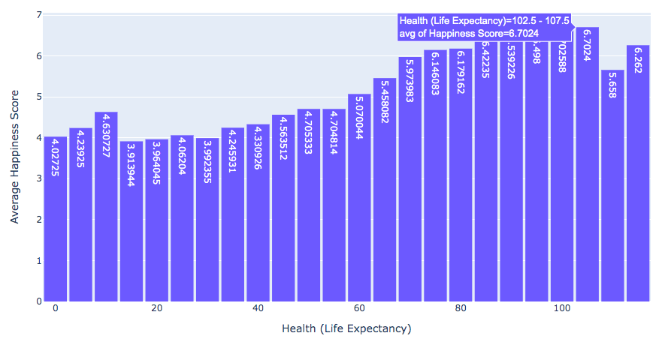
Histogram
Histogram: presents the frequency between different variables
Happiness Score ~ Health (Life Expectancy)
Higher happiness score = higher life expectancy score (vice versa)

Slide 12
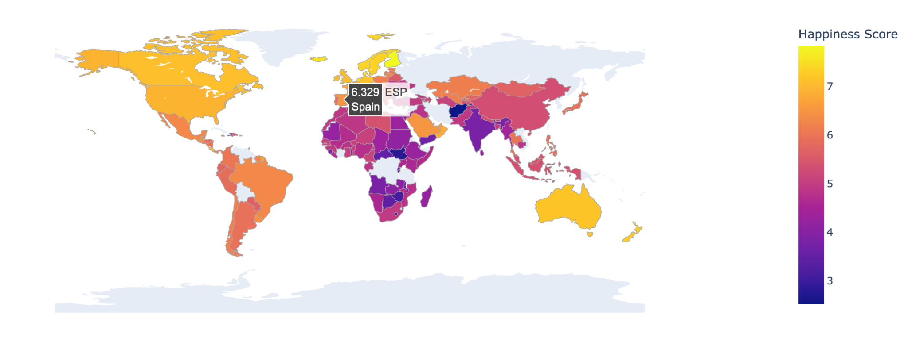
Choropleth Map
A choropleth map is a type of map that uses different colors or shades to represent different values or ranges of values.
This type of map is often used to display statistical data, such as population density or economic indicators, over a geographical area.
In our instance, we are displaying happiness scores over the world map.

Slide 13
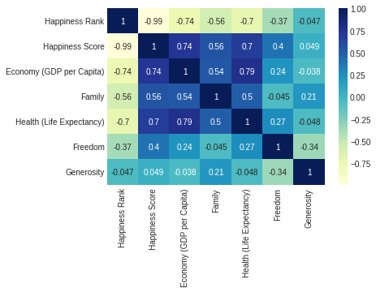
Heatmap
A heat map is a graphical representation of data that can be used to visualize the relationship between different variables.
One possible interpretation of this result is that economic prosperity and good health are essential factors that contribute to happiness.

Slide 14
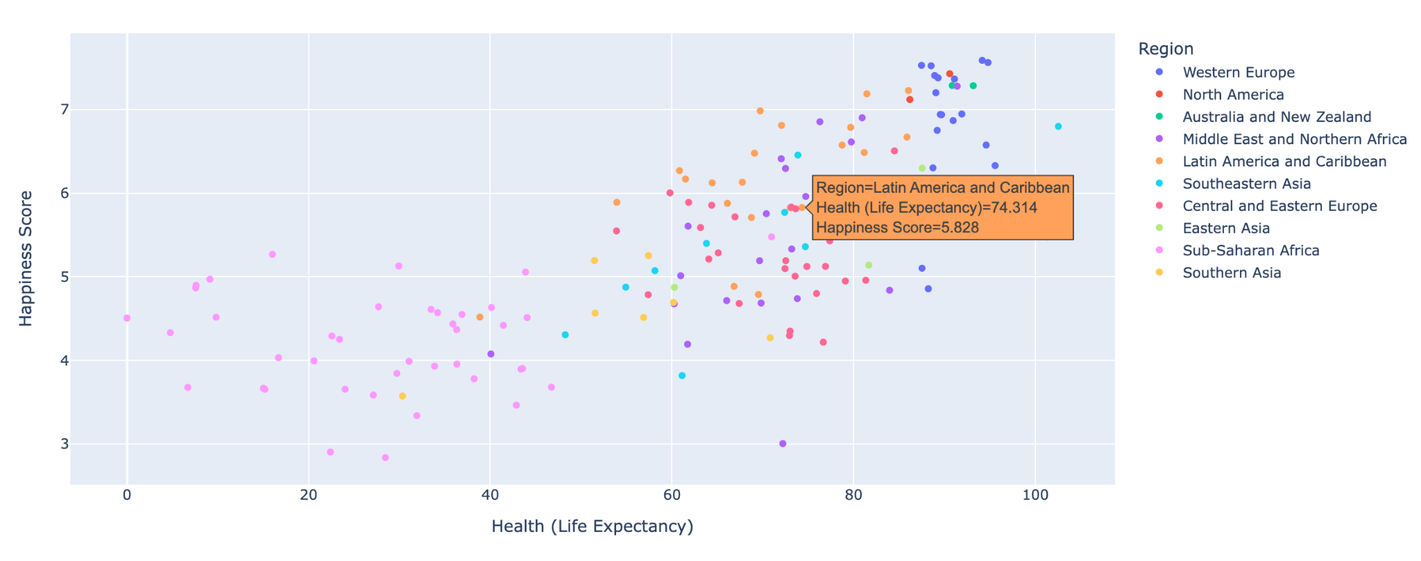
Scatterplot by Region
In this visualization, we plot life expectancy on the x-axis and happiness score on the y-axis.
Each dot's color represents the region the data belongs to, such as North America, Latin America & The Caribbean, Southeastern Asia, and more.
This visualization offers insights for policymakers and researchers and highlight the need for further study of the complex factors that influence happiness

Slide 15

Limitations
While our dataset was fairly comprehensive, it suffered heavily from missing data values and inconsistent column names.
There was a lot of preprocessing to be done and some columns such as trust in the government had to be dropped due to there being insufficient data over the years.
Happiness is a subjective topic.
It does not take into account other factors:
such as education, religion, and other cultural complexities.
Dataset can also be perceived as subjective and vague
making it difficult to precisely measure a meaningful comparison

Slide 16
Conclusion
This study has shown that the economy and health are highly correlated with happiness. Furthermore, our analysis of the World Happiness Report found that countries with higher levels of GDP per capita and longer life expectancy tend to have higher happiness scores.
These results align with previous research on the determinants of happiness, which has consistently identified economic and health factors as essential contributors to subjective well-being.
Therefore, policies that improve the economy and public health also positively impact overall happiness.

